Slide 1
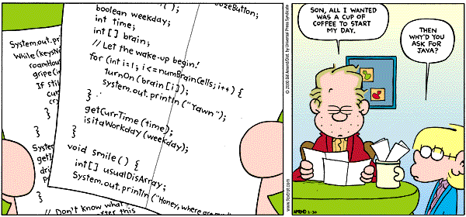
COSC 121 PROJECT

Slide 2
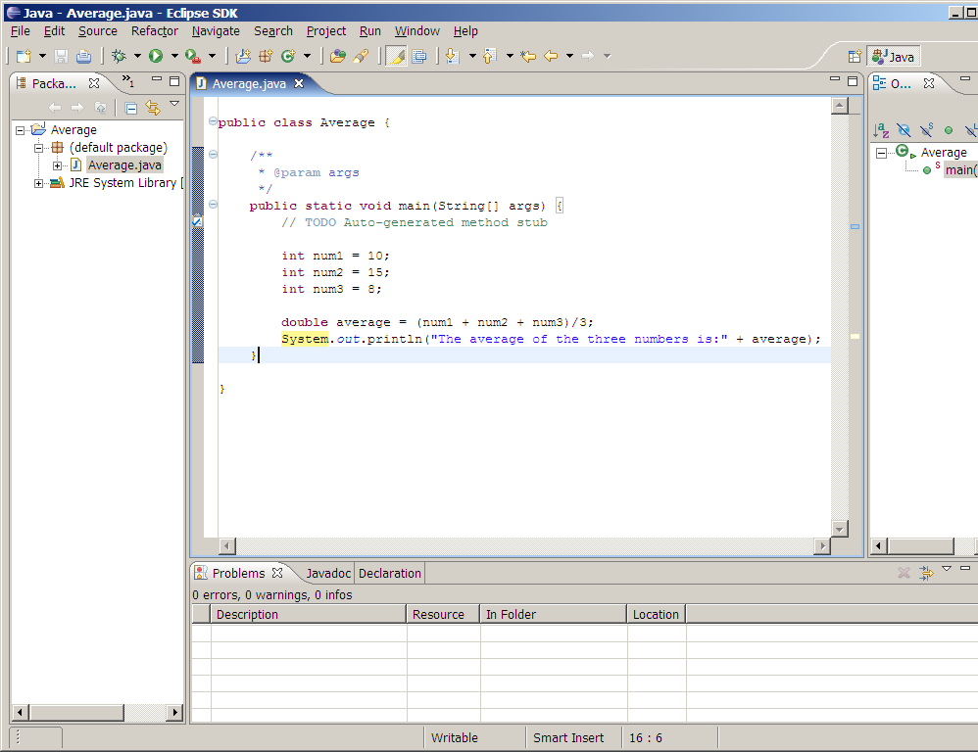
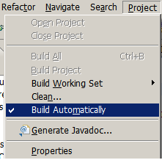

Overview

Slide 3

Overview
Text file
compilation
Executable
(byte code)
Execute (run)
Application running

Slide 4
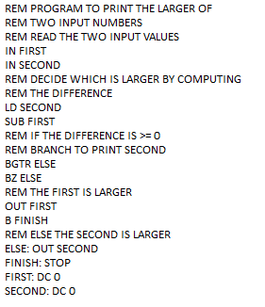
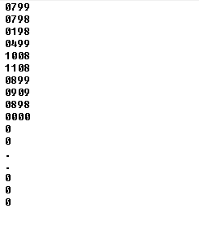

Overview
GIVEN
R E Q U I R E D
Part II: Lab P5
Part I: Lab P1 to P4
COMPILATION
SIMULATION

Slide 5
COSC 121 Project - Part I (Labs P1 to P4)
CPU Simulation

Slide 6
CPU Simulation
Memory
Input
0
1
2
.
.
.
99
Stores the address of the next instruction
Program Counter
Instruction Register
Stores the instruction to execute
Accumulator
Used to store temporary calculations
CPU
Output

Slide 7
The memory
Memory
0
1
2
.
.
.
99
Program
Instruction
Operation Code
Operand
Value between 0 and 11.
Each code corresponds to a specific instruction
Value between 0 and 99.
corresponds to a specific memory address
Variables

Slide 8
Instructions
Instruction Code | Keyword in Language | Action to Execute
0 | STOP | Stop program
1 | LD | ACC ← Memory[Operand]
2 | STO | Memory[Operand] ← ACC
3 | ADD | ACC ← ACC + Memory[Operand]
4 | SUB | ACC ← ACC - Memory[Operand]
5 | MPY | ACC ← ACC * Memory[Operand]
6 | DIV | ACC ← ACC / Memory[Operand]
7 | IN | Display on screen a question mark. Wait for value. Memory[Operand] ← keyboard value
8 | OUT | Display OUTPUT = Memory[Operand]
9 | B | PC ← Operand
10 | BG | If ACC > 0 Then PC ← Operand
11 | BZ | If ACC = 0 Then PC ← Operand

Slide 9
Instructions
Operation Code | Keyword in Language | Action to Execute
0 | STOP | Stop program
1 | LD | ACC ← Memory[Operand]
Memory
Input
01 99
0
1
2
.
.
.
99 | 63
Program Counter
LOAD
OPERAND
Instruction Register
Accumulator
CPU
ACC ← Memory[99]
63
Output

Slide 10
Instructions
Instruction Code | Keyword in Language | Action to Execute
0 | STOP | Stop program
1 | LD | ACC ← Memory[Operand]
2 | STO | Memory[Operand] ← ACC
Memory
Input
02 99
0
1
2
.
.
.
99 | 63
Program Counter
STORE
OPERAND
Instruction Register
25
25
CPU
Memory[99] ← ACC
Output

Slide 11
Instructions
Instruction Code | Keyword in Language | Action to Execute
0 | STOP | Stop program
1 | LD | ACC ← Memory[Operand]
2 | STO | Memory[Operand] ← ACC
3 | ADD | ACC ← ACC + Memory[Operand]
Memory
Input
0
1
2
.
.
.
99 | 63
03 99
Program Counter
Instruction Register
ADD
OPERAND
88
25
CPU
ACC ← ACC + Memory[99]
Output

Slide 12
Instruction Code | Keyword in Language | Action to Execute
0 | STOP | Stop program
1 | LD | ACC ← Memory[Operand]
2 | STO | Memory[Operand] ← ACC
3 | ADD | ACC ← ACC + Memory[Operand]
4 | SUB | ACC ← ACC - Memory[Operand]
Memory
Input
0
1
2
.
.
.
98 | 10
99 | 63
04 98
Program Counter
Instruction Register
SUB
OPERAND
78
88
CPU
ACC ← ACC - Memory[98]
Output

Slide 13
Instructions
Instruction Code | Keyword in Language | Action to Execute
0 | STOP | Stop program
1 | LD | ACC ← Memory[Operand]
2 | STO | Memory[Operand] ← ACC
3 | ADD | ACC ← ACC + Memory[Operand]
4 | SUB | ACC ← ACC - Memory[Operand]
5 | MPY | ACC ← ACC * Memory[Operand]
6 | DIV | ACC ← ACC / Memory[Operand]
7 | IN | Display on screen a question mark. Wait for value. Memory[Operand] ← keyboard value

Slide 14
Memory
Input
0
1
2
.
.
.
98 | 10
99 | 63
07 98
Program Counter
Instruction Register
IN
OPERAND
78
CPU
Display ?
Memory[98] ← keyboard entry
Output
45
?
45

Slide 15
Instructions
Instruction Code | Keyword in Language | Action to Execute
0 | STOP | Stop program
1 | LD | ACC ← Memory[Operand]
2 | STO | Memory[Operand] ← ACC
3 | ADD | ACC ← ACC + Memory[Operand]
4 | SUB | ACC ← ACC - Memory[Operand]
5 | MPY | ACC ← ACC * Memory[Operand]
6 | DIV | ACC ← ACC / Memory[Operand]
7 | IN | Display on screen a question mark. Wait for value. Memory[Operand] ← keyboard value
8 | OUT | Display OUTPUT = Memory[Operand]

Slide 16
Memory
Input
0
1
2
.
.
.
98 | 10
99 | 63
08 99
Program Counter
Instruction Register
78
OUT
OPERAND
CPU
Output
Display OUTPUT = Memory[99]
OUTPUT = 63

Slide 17
Instructions
Instruction Code | Keyword in Language | Action to Execute
0 | STOP | Stop program
1 | LD | ACC ← Memory[Operand]
2 | STO | Memory[Operand] ← ACC
3 | ADD | ACC ← ACC + Memory[Operand]
4 | SUB | ACC ← ACC - Memory[Operand]
5 | MPY | ACC ← ACC * Memory[Operand]
6 | DIV | ACC ← ACC / Memory[Operand]
7 | IN | Display on screen a question mark. Wait for value. Memory[Operand] ← keyboard value
8 | OUT | Display OUTPUT = Memory[Operand]
9 | B | PC ← Operand
10 | BG | If ACC > 0 Then PC ← Operand
11 | BZ | If ACC = 0 Then PC ← Operand

Slide 18
Memory
Input
0
1
2
.
.
.
98 | 10
99 | 63
09 02
10 02
11 02
2
2
5
Instruction Register
-10
B
BG
BZ
OPERAND
78
CPU
Output
If ACC > 0
If ACC = 0
PC ← Operand

Slide 19
Instructions
Instruction Code | Keyword in Language | Action to Execute
0 | STOP | Stop program
1 | LD | ACC ← Memory[Operand]
2 | STO | Memory[Operand] ← ACC
3 | ADD | ACC ← ACC + Memory[Operand]
4 | SUB | ACC ← ACC - Memory[Operand]
5 | MPY | ACC ← ACC * Memory[Operand]
6 | DIV | ACC ← ACC / Memory[Operand]
7 | IN | Display on screen a question mark. Wait for value. Memory[Operand] ← keyboard value
8 | OUT | Display OUTPUT = Memory[Operand]
9 | B | PC ← Operand
10 | BG | If ACC > 0 Then PC ← Operand
11 | BZ | If ACC = 0 Then PC ← Operand

Slide 20
CPU Simulation
Fetch
Increment
Execute
Fetch the next instruction to execute
Increment program counter
Execute the instruction
Notes:
Describe relationship parent child (IS_A)
Show difference variables and methods
Show how certain methods can only be abstract and what that means.

Slide 21
Memory
Increment
Execute
Fetch
0 | 0799
1 | 0798
2 | 0198
3 | 0499
4 | 1008
5 | 1108
6 | 0899
7 | 0909
8 | 0898
9 | 0000
10
…
98 | 10
99 | 63
0799
Input
PC
Program Counter
PC ← PC + 1
3
7
9
0
10
2
1
5
8
4
6
IR
IR ← Memory[PC]
04 | 99
07 | 99
07 | 98
10 | 08
09 | 09
08 | 99
00 | 00
11 | 08
Instruction Register
01 | 98
0799
0198
0798
0499
1008
0899
0909
0000
1108
ACC
Accumulator
43
-16
PC ← Operand
If ACC = 0 Then
PC ← Operand
Stop
If ACC > 0 Then
PC ← Operand
OUTPUT = 59
?
59
43
CPU
ACC ← ACC – Memory[Operand]
ACC ← Memory[Operand]
43
Output
59

Slide 22
Memory
Increment
Execute
Fetch
0 | 0799
1 | 0798
2 | 0198
3 | 0499
4 | 1008
5 | 1108
6 | 0899
7 | 0909
8 | 0898
9 | 0000
10
…
98 | 10
99 | 63
Input
PC
Program Counter
PC ← PC + 1
8
9
0
2
5
3
10
1
4
IR
IR ← Memory[PC]
08 | 98
00 | 00
04 | 99
07 | 99
07 | 98
10 | 08
Instruction Register
01 | 98
0198
0799
0798
0499
1008
0898
0000
ACC
Accumulator
43
30
If ACC > 0 Then
PC ← Operand
OUTPUT = 43
Stop
?
13
43
CPU
ACC ← ACC – Memory[Operand]
ACC ← Memory[Operand]
43
Output
13

Slide 23
How to program that???
Memory
Input
0
1
2
.
.
.
99
Program Counter
Instruction Register
Accumulator
CPU
Output

Slide 24
Class | Instance Variable(s) | Methods
Memory | int[] storage | getValueAt(location) setValueAt(location) loadProgram()
ProgramCounter | int value | getValue() setValue() incrementPC()
InstructionRegister | int value | setValue() getOpCode() getOperand()
Accumulator | int value | getValue() setValue() add(), subtract(), multiply(), divide()
Terminal |  | input() output(value)
Computer | Memory ram ProgramCounter pc InstructionRegister ir Accumulator acc Terminal | run()

Slide 25
Home Assignment
Check Connect

